Slide 1
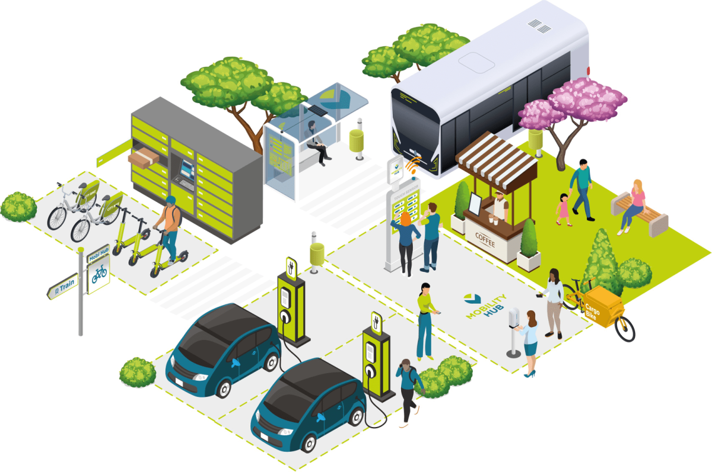

OSLO Passenger Transport Hubs:
Thematic workshop 1
Welcome!
Thursday 19th of May 2022
Virtual workshop – Microsoft Teams
We start at 09:05am

Slide 2



Before we start…
Mute yourself during the meeting
Raise your hand before speaking. We encourage interaction!
Questions and suggestions can always be communicated via the chat.
Recorded
yes/no questions can be answered via the chat:
Yes = +1
No = - 1
Neutral = 0

Slide 3


Objective
Explanation and elaboration on discussion points of last session
Giving a summary of the business workshop
Presentation of and gathering input on the revised model for this data standard

Slide 4
Topics
09:00 - 09:10 AM | Welcome and introduction | Arne Scheldeman (DF)
09:10 - 09:25 AM | Recap of last workshop | Arne Scheldeman (DF)
09:25 - 09:40 AM | UML | Arne Scheldeman (DF)
09:40 - 09:50 AM | Passenger Transport Hub intro | Alexis Driesen (DF)
09:50 - 10:50 AM | Discussion points | Arne Scheldeman (DF)
10:50 - 11:05 AM | Break
11:05 - 11:20 AM | Passenger Transport Hub model | Arne Scheldeman (DF)
11:20 - 11:30 AM | Q&A en next steps | Arne Scheldeman (DF)

Slide 5

Who is who?

Slide 6
Recap of the business workshop

Slide 7


Topics of the business workshop
Introduction to the project and OSLO
Hoppinpoints
Passenger Transport Hubs Model
Green mobility data models for smart ecosystems.
Translation of Hoppinpoints standard.
GreenMov + Digital Flanders
Open Standards for Linked Organisations (OSLO).
Semantic and Technical interoperability
Exchange and reuse of data
A type of Passenger Transport Hub, a node of different transport options adjusted to each other enabling users to change transport means smoothly.
Model from which the Passenger Transport Hubs model is derived.
Reuse of Flemish standard ‘Hoppinpoints’ to build a European standard.
Presentation of the first draft of the model.
Brainstorm about use cases and concepts using post-its in MURAL.

Slide 8
Scope of this project
Develop a semantic framework for mapping Passenger Transport Hubs and sharing data.
Develop a sustainable application profile and vocabulary for Passenger Transport Hubs.
We follow the OSLO methodology, which means:
We start from use cases
We align as much as possible with existing standards
We define cases ourselves where necessary

Slide 9
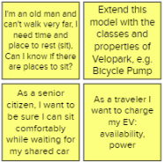
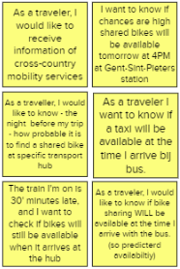
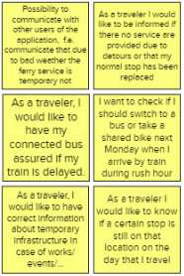
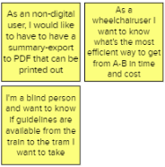
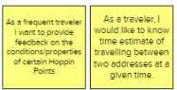
Use cases business workshop
Real-time information
Infrastructure
Availability
Accessibility
Others

Slide 10
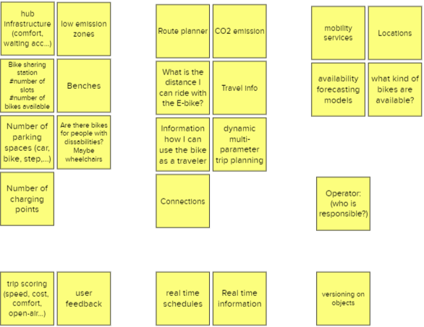
Data concepts
Infrastructure
Travelling
Availability
Persona
Real-time information
Feedback
Versioning

Slide 11
Unified Modeling Language
(UML)

Slide 12
Concepts or Classes
Person
Address
Animal
Asylum

Slide 13
Attributes
Person
Address
identification
name
surname
contactInformation
street
houseNumber
boxNumber
postalCode
municipality
country
Animal
Asylum
identification
name
type
race
birthDate
picture
identification
name
website
contactInformation

Slide 14
Association
Person
Address
Has address
is contact person by
adopts
has address
Animal
Asylum
taken care of by

Slide 15
Generalisation
Animal
Inheritance
Dog
Cat

Slide 16
Aggregation
Asylum
Building
License

Slide 17
Cardinality
Person
Address
1..1
0..*
0..1
1..1
0..*
0..*
Animal
Asylum
0..*
0..1

Slide 18
The model
Person
Address
identification
name
surname
contactInformation
has address
street
houseNumber
boxNumber
postalCode
municipality
country
Is contact person at
adopts
has address
Animal
Asylum
identification
name
type
race
birthDate
picture
Is taken care of by
identification
name
website
contactInformation

Slide 19
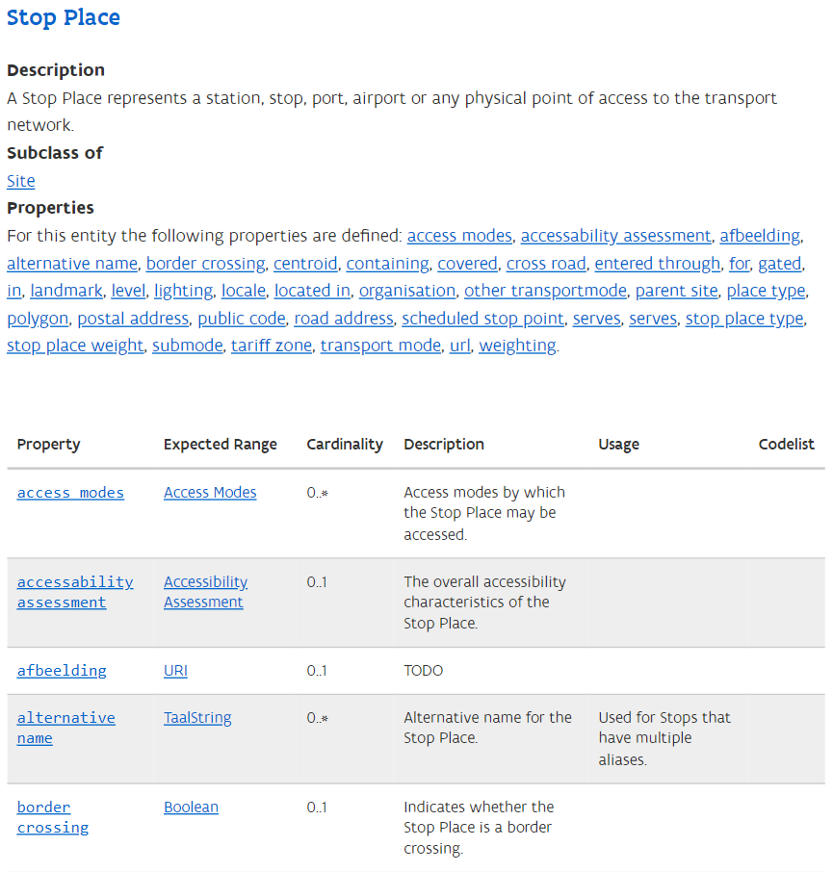
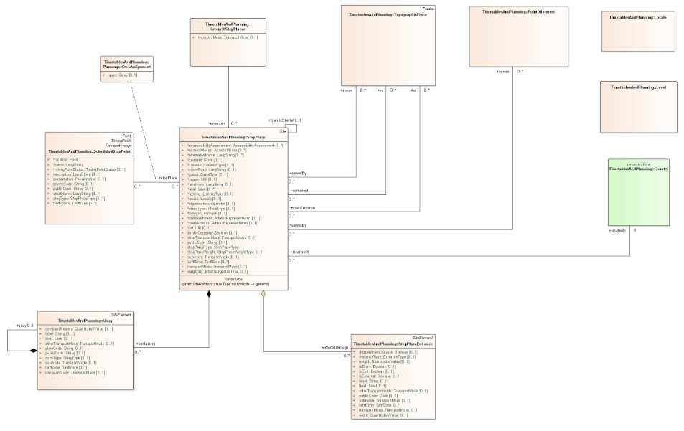
UML & HTML

Slide 20
Passenger Transport Hubs

Slide 21
Reuse of Flemish standard
Existing Flemish standard (OSLO Hoppinpunten)
Basis of this track
Based on (inter)national standards
Inspire (transport networks)
Mobivoc
NeTEx (Stop Places)
OSLO Mobiliteit: Trips en aanbod (OSLO Mobility: Trips and offers)
OSLO Mobiliteit: Planning en dienstregeling (OSLO Mobility: Planning and schedule)
OSLO Openbaar domein (OSLO Public domain)

Slide 22
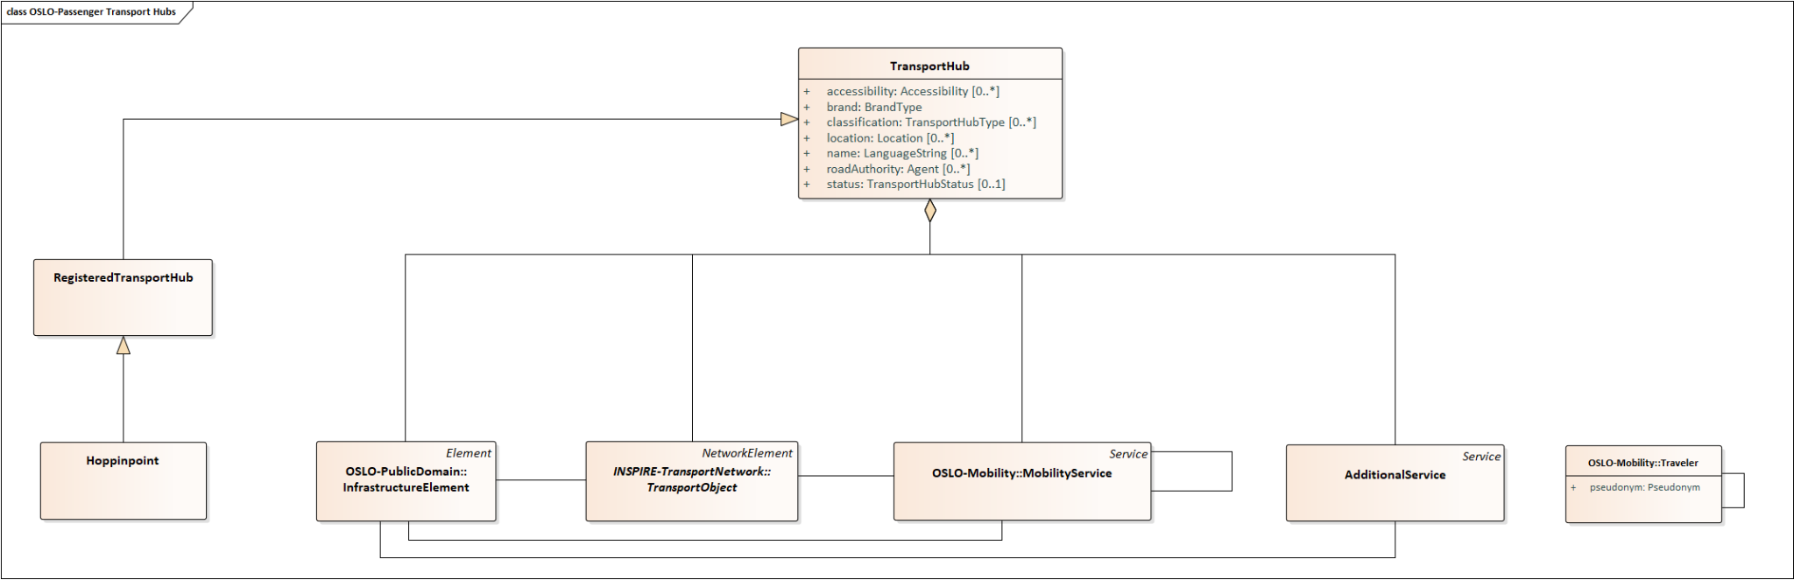
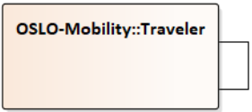
Foundation of the model
→ References to other models are also translated in English now

Slide 23
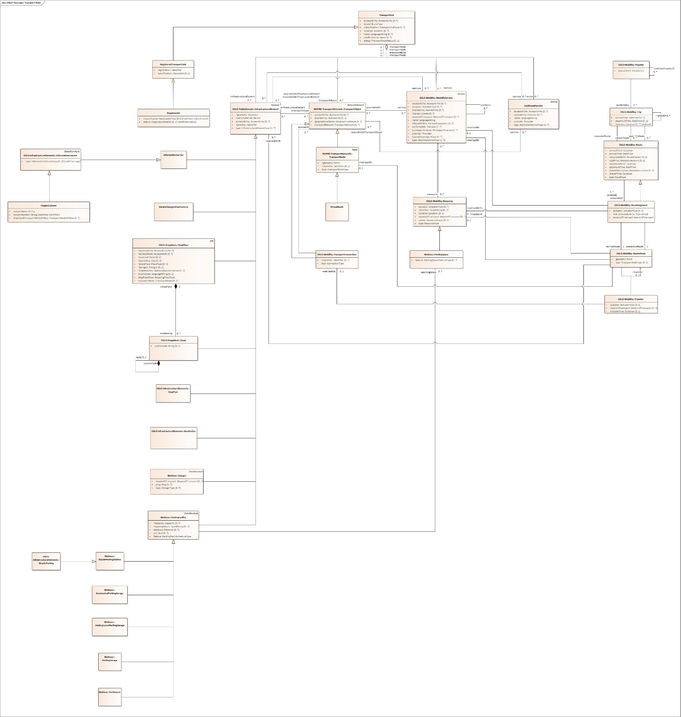
Full model

Slide 24
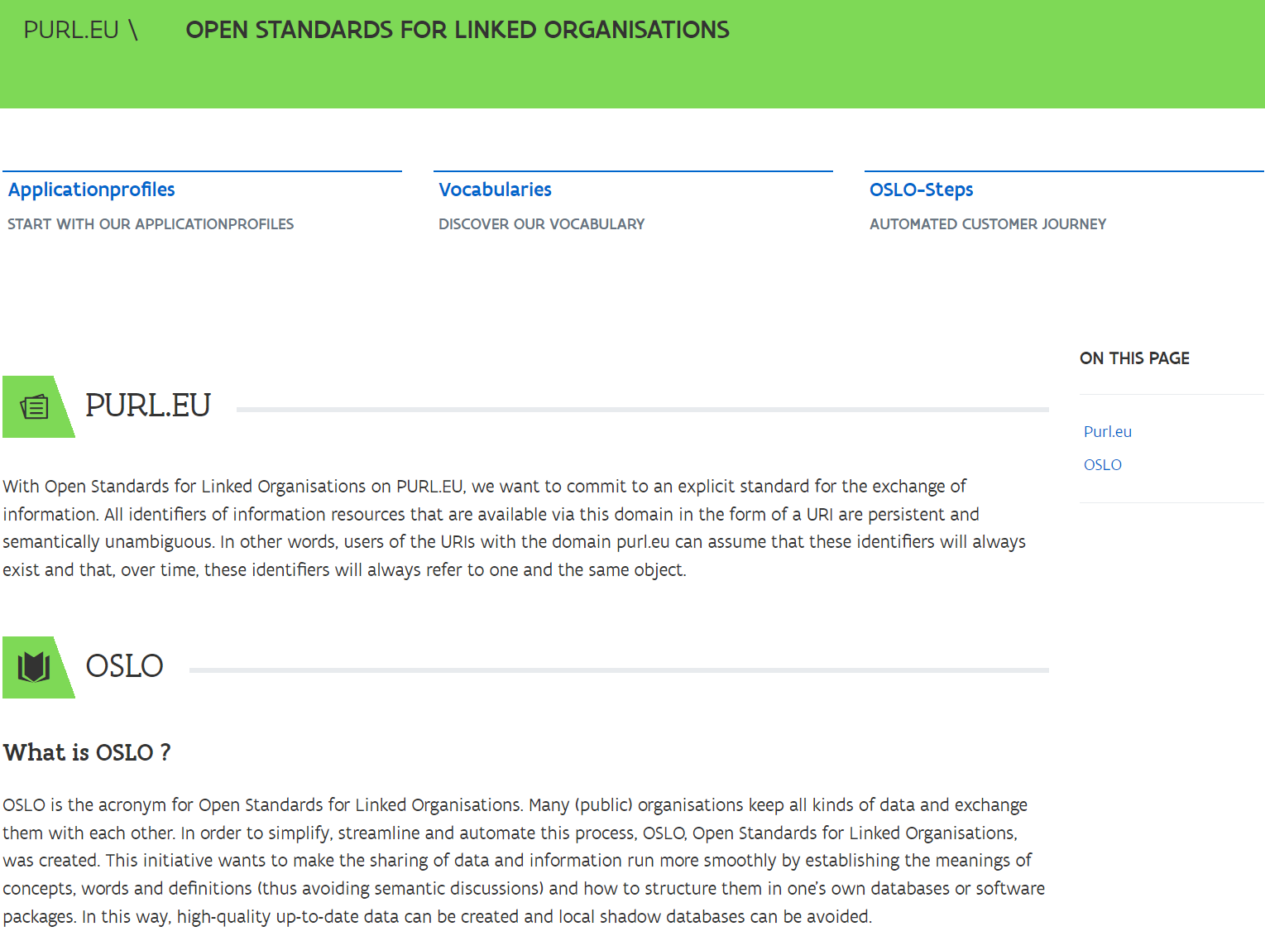
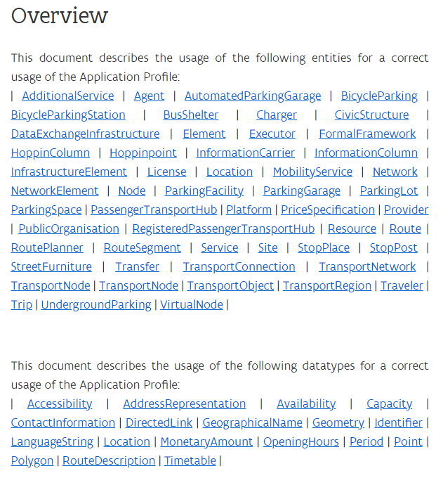
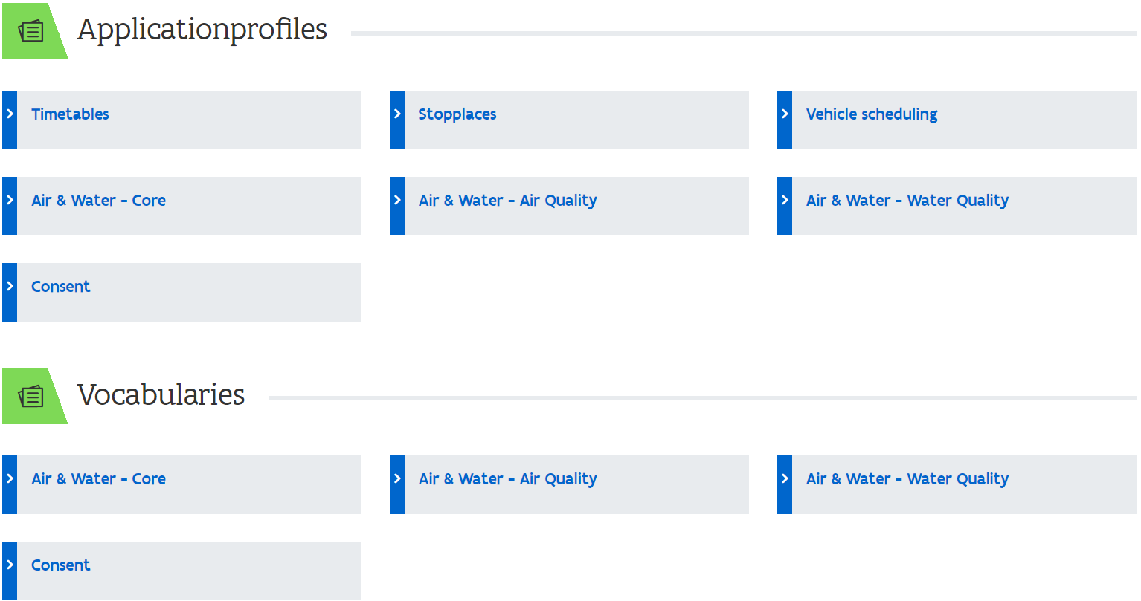
PURL.eu

Slide 25
Discussion Points

Slide 26
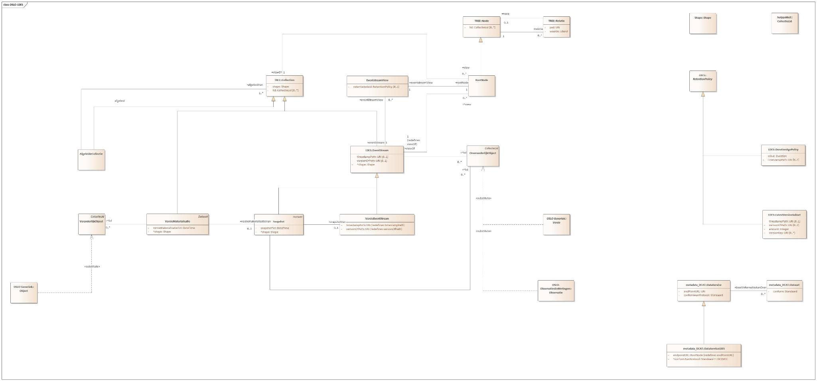
Versioning - OSLO LDES
LDES = Linked Data Event Streams
Collection of Versions, Observations etc (ImmutableObjects)
Fragmentation: e.g. by pagination
OSLO-LDES: extension on W3C-LDES (also an extension, of TREE)
Usage: synchronising a replica OR direct querying
Does this present the predicted or the real trip? What about occurring differences?
Versioning on objects
How would this model deal with traffic, or a strike causing blocked streets
Notes:
Immutable object: Objecten die niet kunnen wijzigen. Vb op een observatie kan niet worden teruggekomen/temperatuur... . De tijd zorgt ervoor dat je niet kan terugkomen op een bepaalde versie/toestand.
Terugkomen op data uit het verleden is not done. Wijzigingen zorgen voor een nieuwe versie.
Tree --> niets over evenstreams
OSLO --> toevoeging van snapshots en metadata
Usage: Data lokaal cachen en inschrijven op de eventstream; up to date houden.

Slide 27
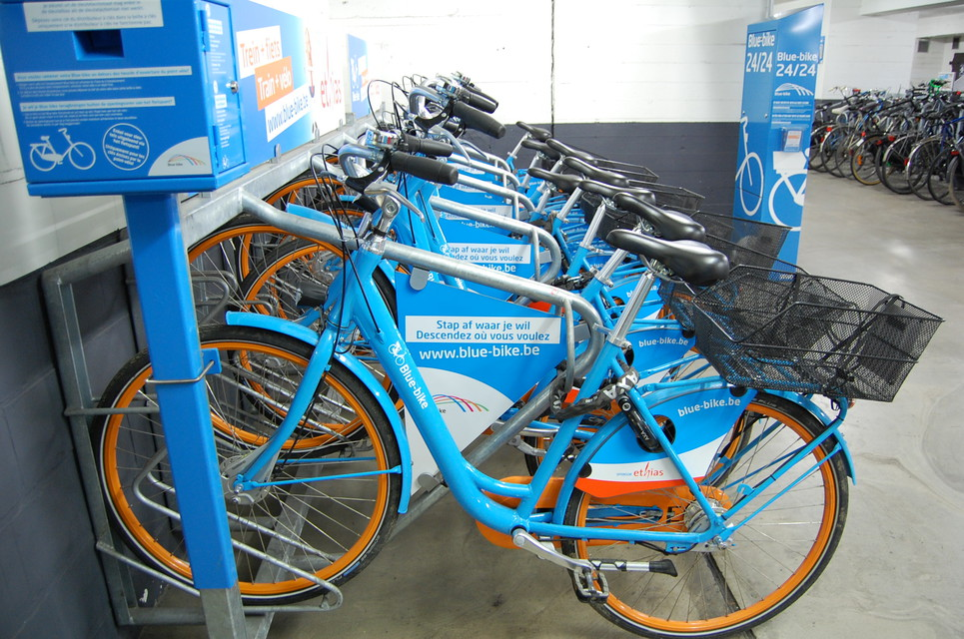

LDES data-example
Assumption: we are going to synchronise our replica-database
E.g. by polling the EventStream
Here: the Evenstream of OSLO PTH → Resource
To ensure that it is up-to-date (in order that we always know the correct number of available bikes in a train station, e.g. Blue-bikes in this example).

Slide 28
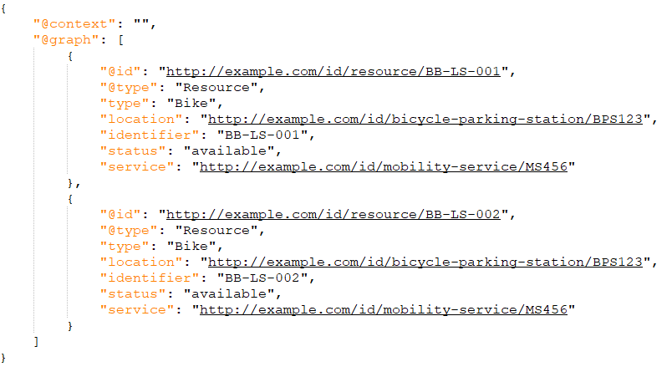
LDES data-example
Let’s assume that our replica of the Resources database looks like this at 9am.
Two bikes are available at that moment:
Bike BB-LS-001
Bike BB-LS-002
They are in BicycleParkingStation BPS123 (in Leuven station)
And provided by MobilityService MS456 (Blue-bike service)
Notes:
Uri's zitten meegenomen in @context wat hierin niet uitgemodelleerd is. Vb bij @typeUri's zitten meegenomen in @context wat hierin niet uitgemodelleerd is. Vb bij @type

Slide 29
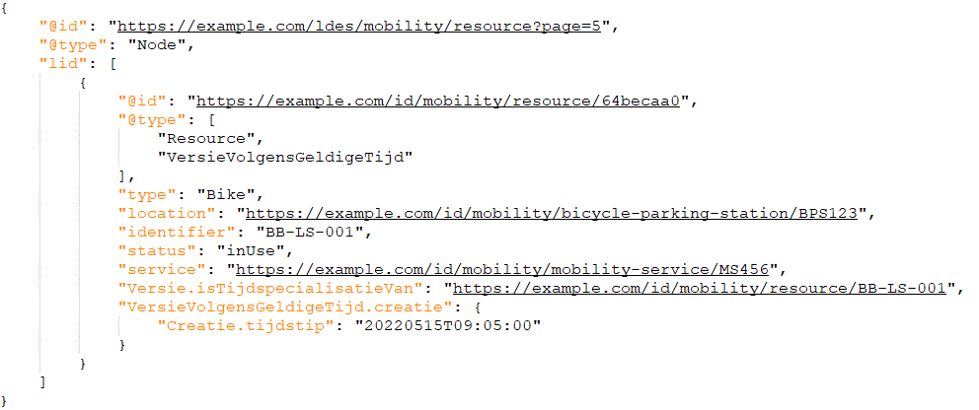
LDES data-example: Evenstream, Node
When polling the PTH:Resource Eventstream e.g. at 9:15am we see a new version for bike BB-LS-001
The status of the bike changed from “available” to “inUse” at 9:05am.
The Evenstream (https://example.com/ldes/mobility/resource) presents updates page by page.
Here the update was found on page 5 (the pages are called Nodes in LDES)
REMARK: For illustrative reasons the page presents only one update, there could have been a lot more.
2
1
1
2

Slide 30
LDES data-example: Version
Version is modelled according to OSLO-Generics (based on the PROV-ontology).
The update is of type VersionInValidtime (i.e. the Version of this Resource in real- time).
It remains a Resource, while the update is a Version and a Resource at the same time. Thus, it has attributes of both.
It has a version id, here implemented as a GUID.
Being a Version, it inherited the attributes of this class, like a pointer to the original Object and the time the Version was created (which is 9:05am).
1
2
1
2
3
3

Slide 31
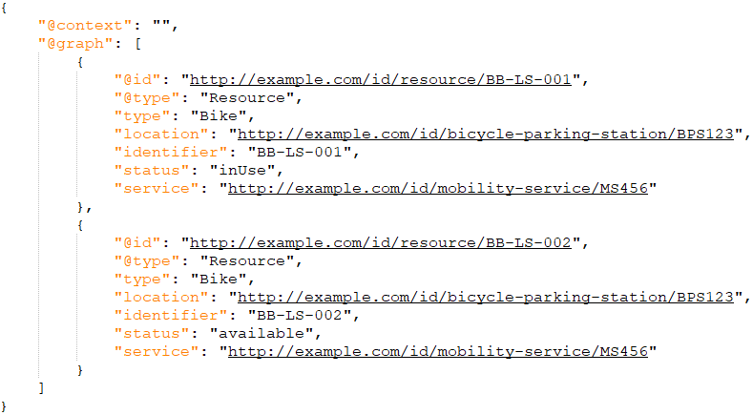
LDES data-example: Processing
After processing the update, we see in our replica that only bike BB-LS-002 is still available
A count for BicycleParkingStation BPS123 (in Leuven station) would show that the number of available bikes is now 1

Slide 32
LDES data-example: remarks
+
-
No need for a queryable remote database or dedicated remote services.
More processing & caching client-side, although only the EventStreams that are necessary should be replicated
Others?

Slide 33
Real-time Capacity
I want to know if chances are high that a shared bike will be available tomorrow at 4pm at the Gent-Sint-Pieters station.
Real-time capacity - calculation
Implicit
Explicit
No change in the model.
No explicit visibility of the amount of available resources.
Summation of available resources needs to be calculated.
Explicit visibility of the amount of available resources.
Change in model: Extra attribute within class MobilityService: /realtimeResource
Calculations of extra versions necessary each time a change within Resources happens.
The amount of queries necessary to stay in sync
As a traveler I want to know if a taxi will be available at the time I arrive by bus.
The train I’m on is 30min late, and I want to check if bikes will still be available when it arrives at the transport hub.
Notes:
Mobiliteitsservices…
Welk type van resources…

Slide 34
Real-time Capacity
I want to know if chances are high that a shared bike will be available tomorrow at 4pm at the Gent-Sint-Pieters station.
Real-time capacity - Reservation
Booking/reservation is included within OSLO Mobility: Trips & Offers.
Reservation
Decision by the provider (ex. Velo, Bird, BlueBike)
They choose if reservations are possible AND for which time period
English translation of OSLO Mobility - Trips and Offers is in the pipeline!
As a traveler I want to know if a taxi will be available at the time I arrive by bus.
The train I’m on is 30min late, and I want to check if bikes will still be available when it arrives at the transport hub.

Slide 35
Real-time Information
In essence, as a traveler, you would like to know if a certain mobility option WILL be available at the time you arrive at the certain point.
How does the model satisfies this?:
All information is present about current state
Resources, Infrastructure, Services…
Discussion:
Concepts like delay/incidents which make a service unavailable lack in the model.
To be included in this model?
Take it with us to another model?
Concepts
Canceled service
Delays
Incidents
Possibility to communicate with other users of the application, f.e. communicate that due to bad weather the ferry service is temporary not working, so that all users who are following the same traject can see this information (same as Waze)
As a traveler I would like to be informed if there no service are provided due to detours or that my normal stop has been replaced
I want to check if I should switch to a bus or take a shared bike next Monday when I arrive by train during rush hour.
As a traveler, I would like to have correct information about temporary infrastructure in case of works/ events/…
As a traveler, I would like to have my connected bus assured if my train is delayed
As a traveler, I would like to know if a certain stop is still on that location on the day that I travel

Slide 36
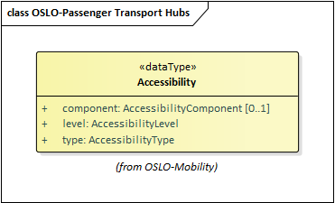
Accessibility
I’m a blind person and I want to know if guidelines are available form the train to the tram I want to take.
Accessibility within a transport hub is divided into three parts:
Level of accessibility: e.g. Accessible with support, fully accessible…
Component of accessibility: The component of the passenger hub to which the accessibility applies. E.g. infrastructure, mobility service…
Type of accessibility: e.g. information accessible, service accessible, physically accessible…
As a wheelchair user I want to know if the transport hub is accessible.
As a wheelchair user I want to know what the most efficient way to get from A-B in time and cost is.

Slide 37
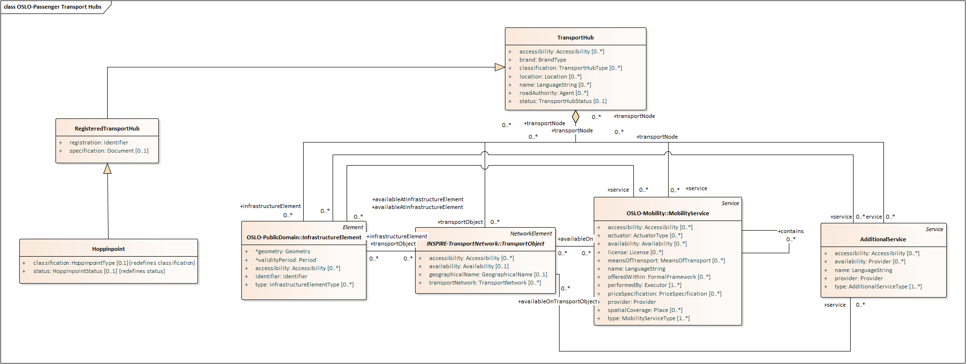
Accessibility

Slide 38
Feedback
Feedback at the level of a Transport Hub is not in scope of this track
Hypothetically, if we were to include it:
Feedback would be connected to the actual trip
Attributes on different classes:
Service
Infrastructure
Object
In the form of:
Star rating
Text
Very difficult to map and process non-structured feedback in text format
Trip scoring (speed, cost, comfort, open-air…)
User feedback

Slide 39
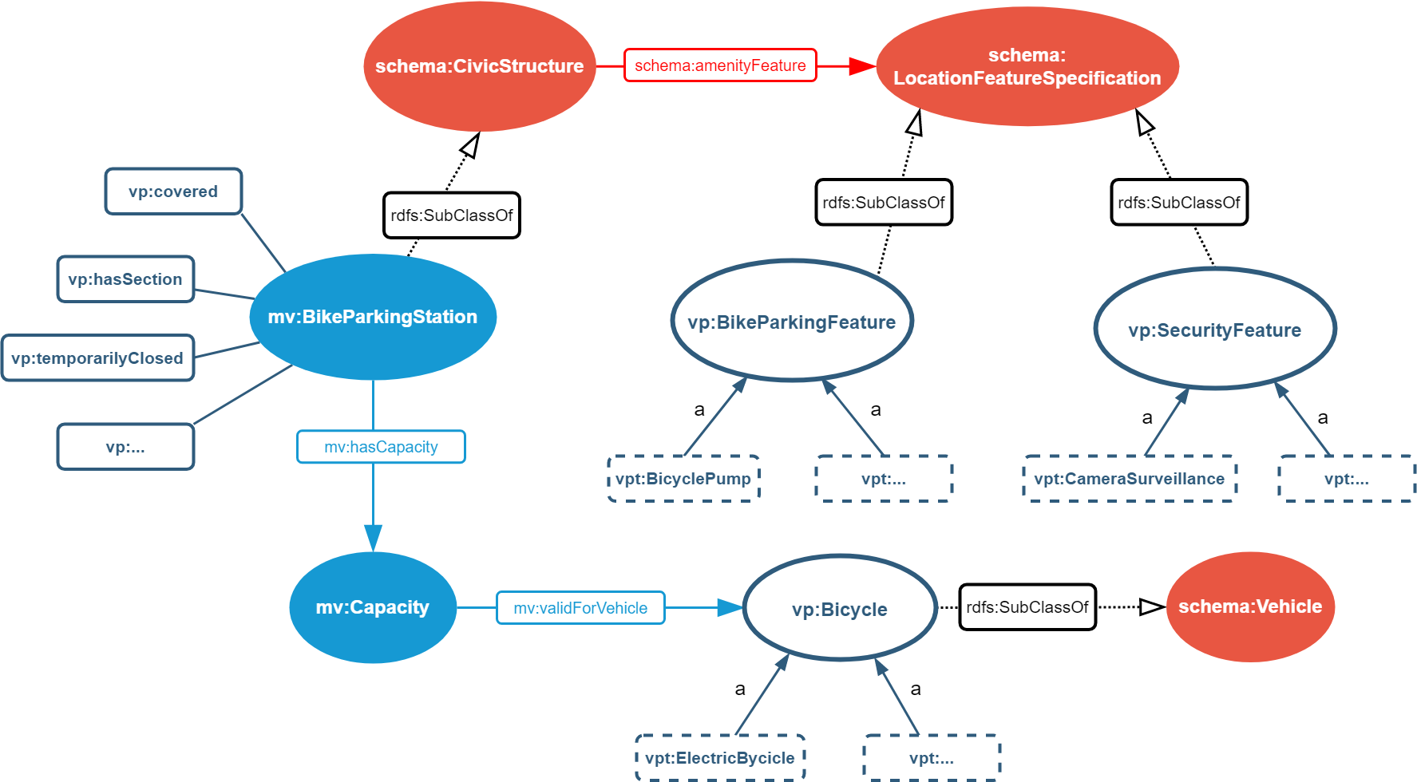
Data standard Velopark
Data standard to effectively describe bicycle parking facilities
The core of OVV is based on MobiVoc → Schema.org data model
Difference in modelling?
Velopark: Features within Velopark are modelled as instances
OSLO: Features are included as types, where an enumeration is created to include the different features.
How to include Velopark in OSLO?
Include the features as AdditionalService of the InfrastructureElement.
BicyclePump as additional service on the BikeParkingStation
Open Velopark Vocabulary

Slide 40
Data standard Velopark
Data standard to effectively describe bicycle parking facilities
The core of OVV is based on MobiVoc → Schema.org data model
Difference in modelling?
Velopark: Features within Velopark are modelled as instances
OSLO: Features are included as types, where an enumeration is created to include the different features.
How to include Velopark in OSLO?
Include the features as AdditionalService of the InfrastructureElement.
BicyclePump as additional service on the BikeParkingStation
Open Velopark Vocabulary

Slide 41
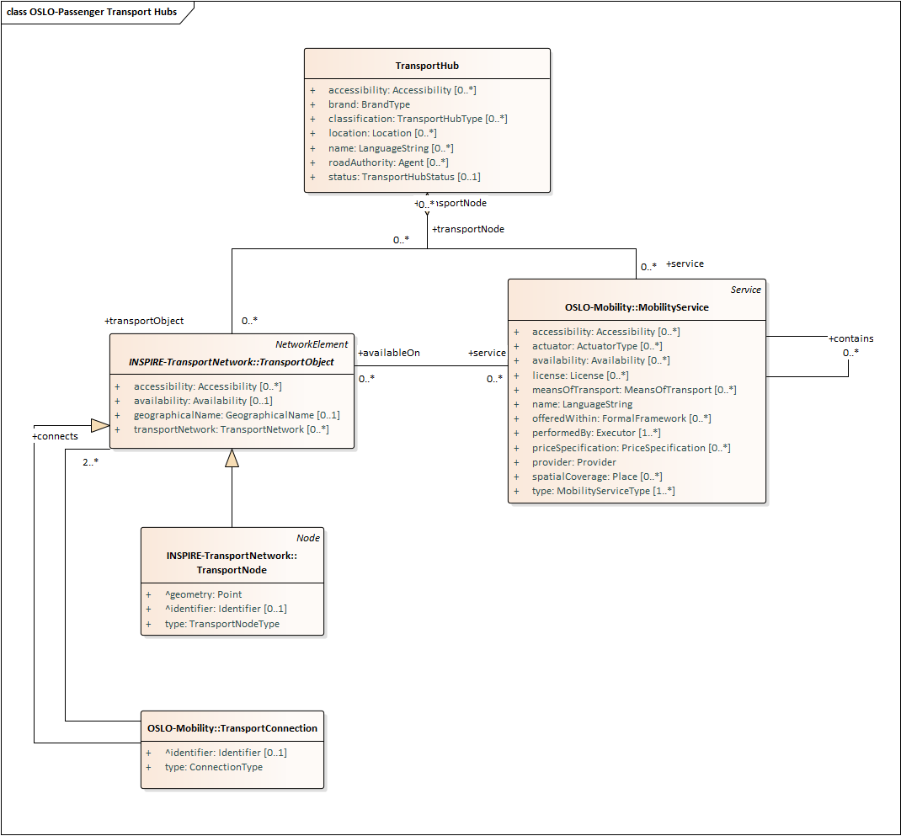
Transport hub & Route planning
Route within the Transport Hubs
Possibility to calculate the distance between mobility services based on the nodes connected to the specific services and their connection.
Route planning - Shortest path
If the Transport Hub is the starting point of the Traveler’s trip, then the node of the first mobility service will be used within the path. However, the calculation itself is a black box and out of scope of this track.

Slide 42

Passenger Transport Hubs model

Slide 43
Q&A and Next Steps

Slide 44

What do we do…?
Don’t we have to add …?
Can’t we better …?
What about …?
Didn’t we forget …?

Slide 45
Next steps
Process the input.
Distribution of a report from this workshop. Feedback is certainly welcome!
Further investigation and preparation of the second thematic workshop.
Information gathering via GitHub!

Slide 46
Planning
Thematic workshop 23th of June (09:00am - 12:00am)
Register via the following link:
Business workshop
Thematic workshop 2
Start public review period
End public review period
2022
April
May
June
July
August
September
October
November
December
Thematic workshop 1
Thematic workshop 3 (Optional)
Implementation of the draft specification
Today

Slide 47

How to collect the presentations/report?
Follow the steps in the intro on the GitHub page.

Slide 48


Feedback & cooperation
Feedback/input can be provided via GitHub:
https://github.com/Informatievlaanderen/OSLOthema-passengerTransportHubs
Through the creation of issues
Feedback can be provided by e-mail to the following persons:
digitaal.vlaanderen@digitaal.vlaanderen.be
laurens.vercauteren@vlaanderen.be
arne.scheldeman@vlaanderen.be

Slide 49
Thank you!

